Slide 1

Analyzing Cy Young Award Winners
Presented by: Xander Cho, Derek Cunius, Benett Dervishaj, and Andrew Fish

Slide 2
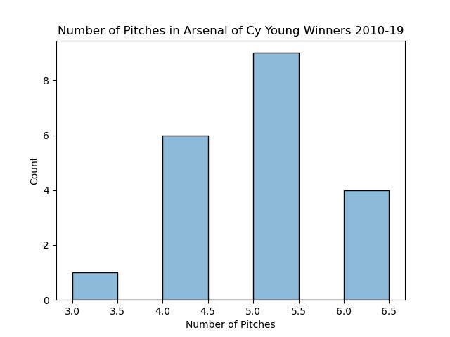
Pitch Arsenal

Slide 3
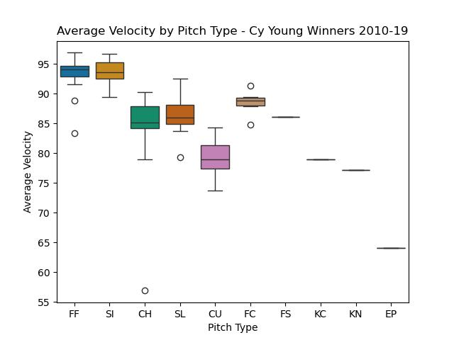
Velocity

Slide 4
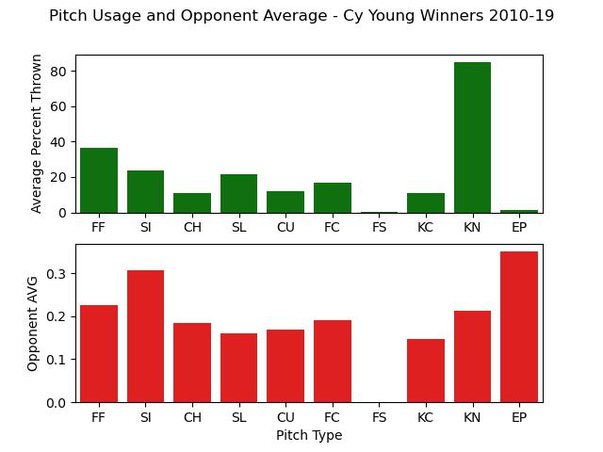
Usage and Opponent Average

Slide 5
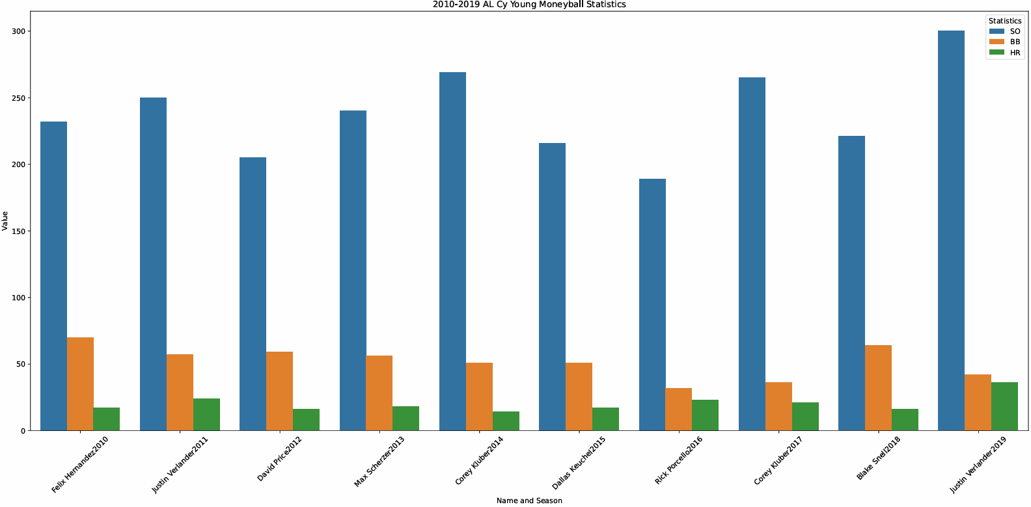
AL Moneyball Metrics

Slide 6
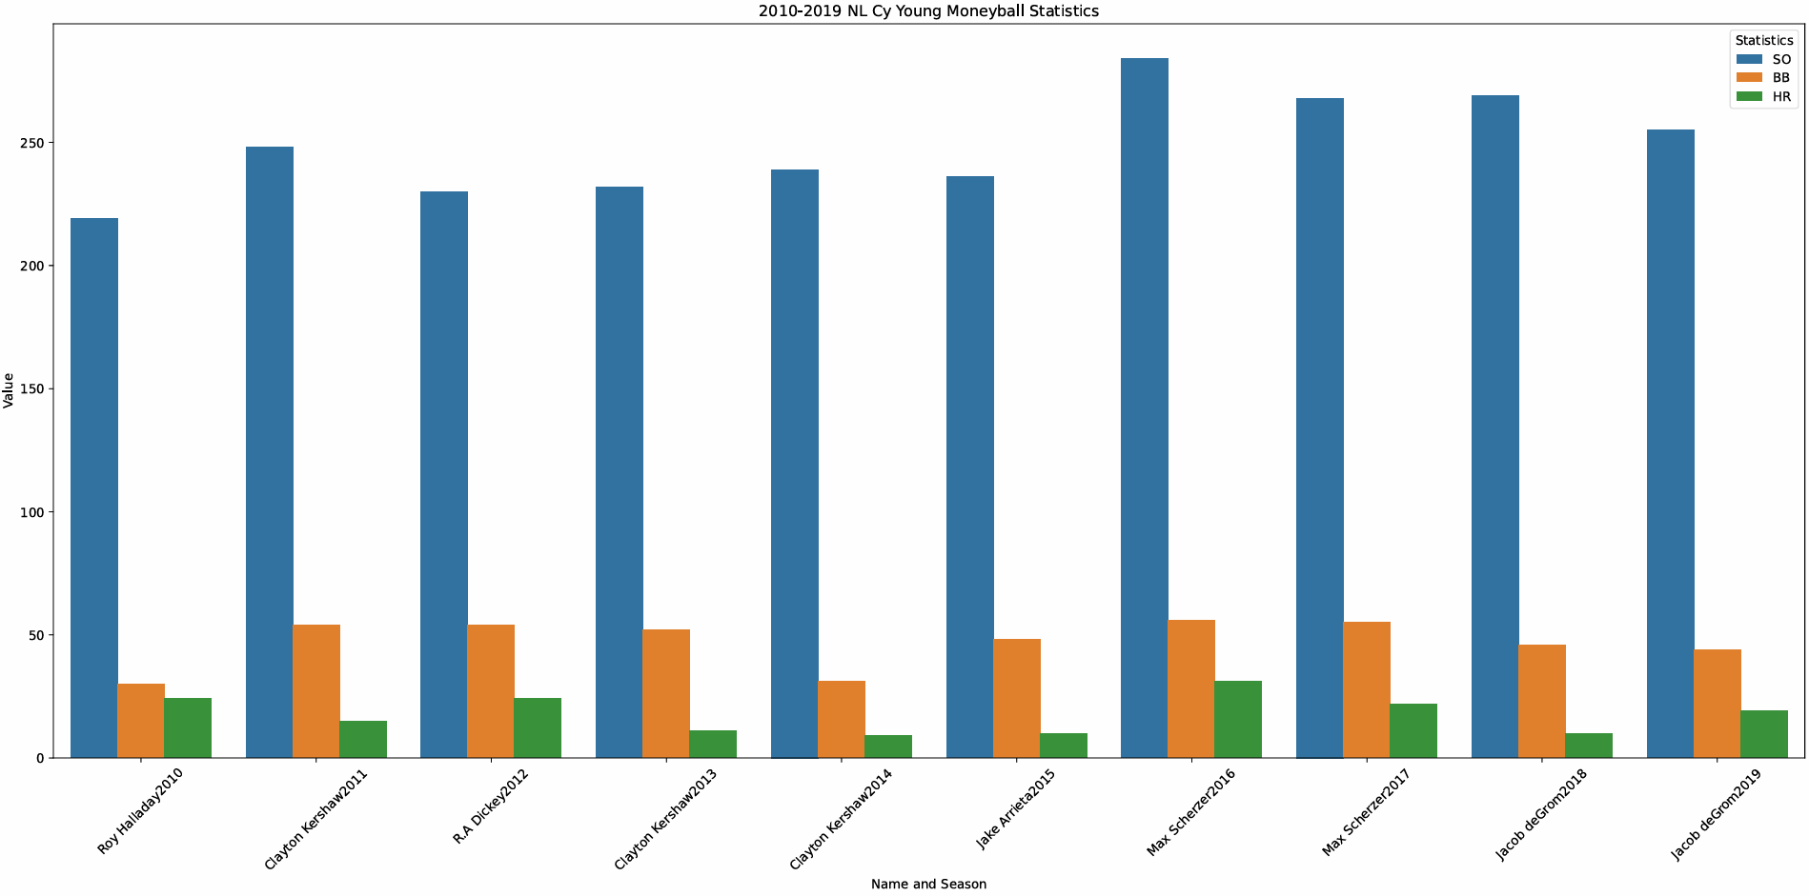
NL Moneyball Metrics

Slide 7
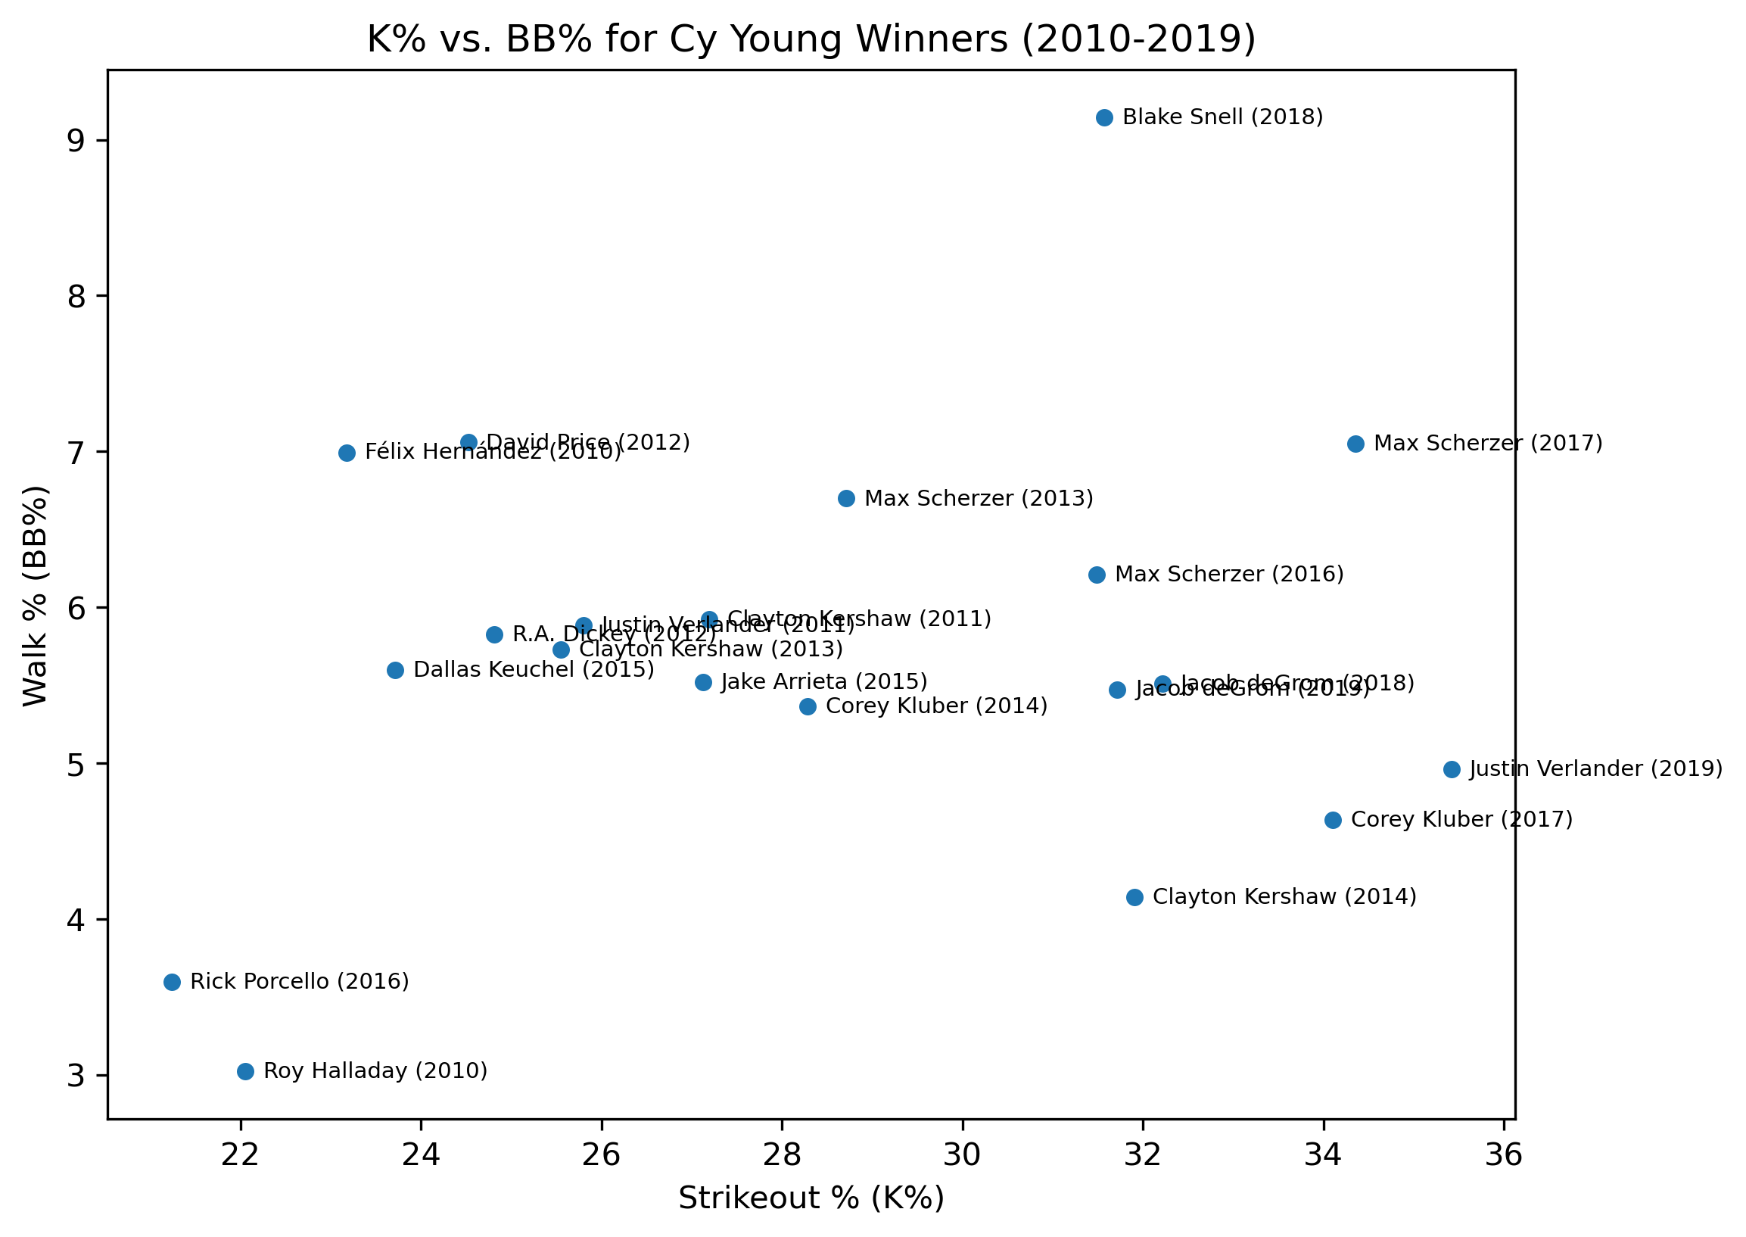
K% vs. BB%

Slide 8
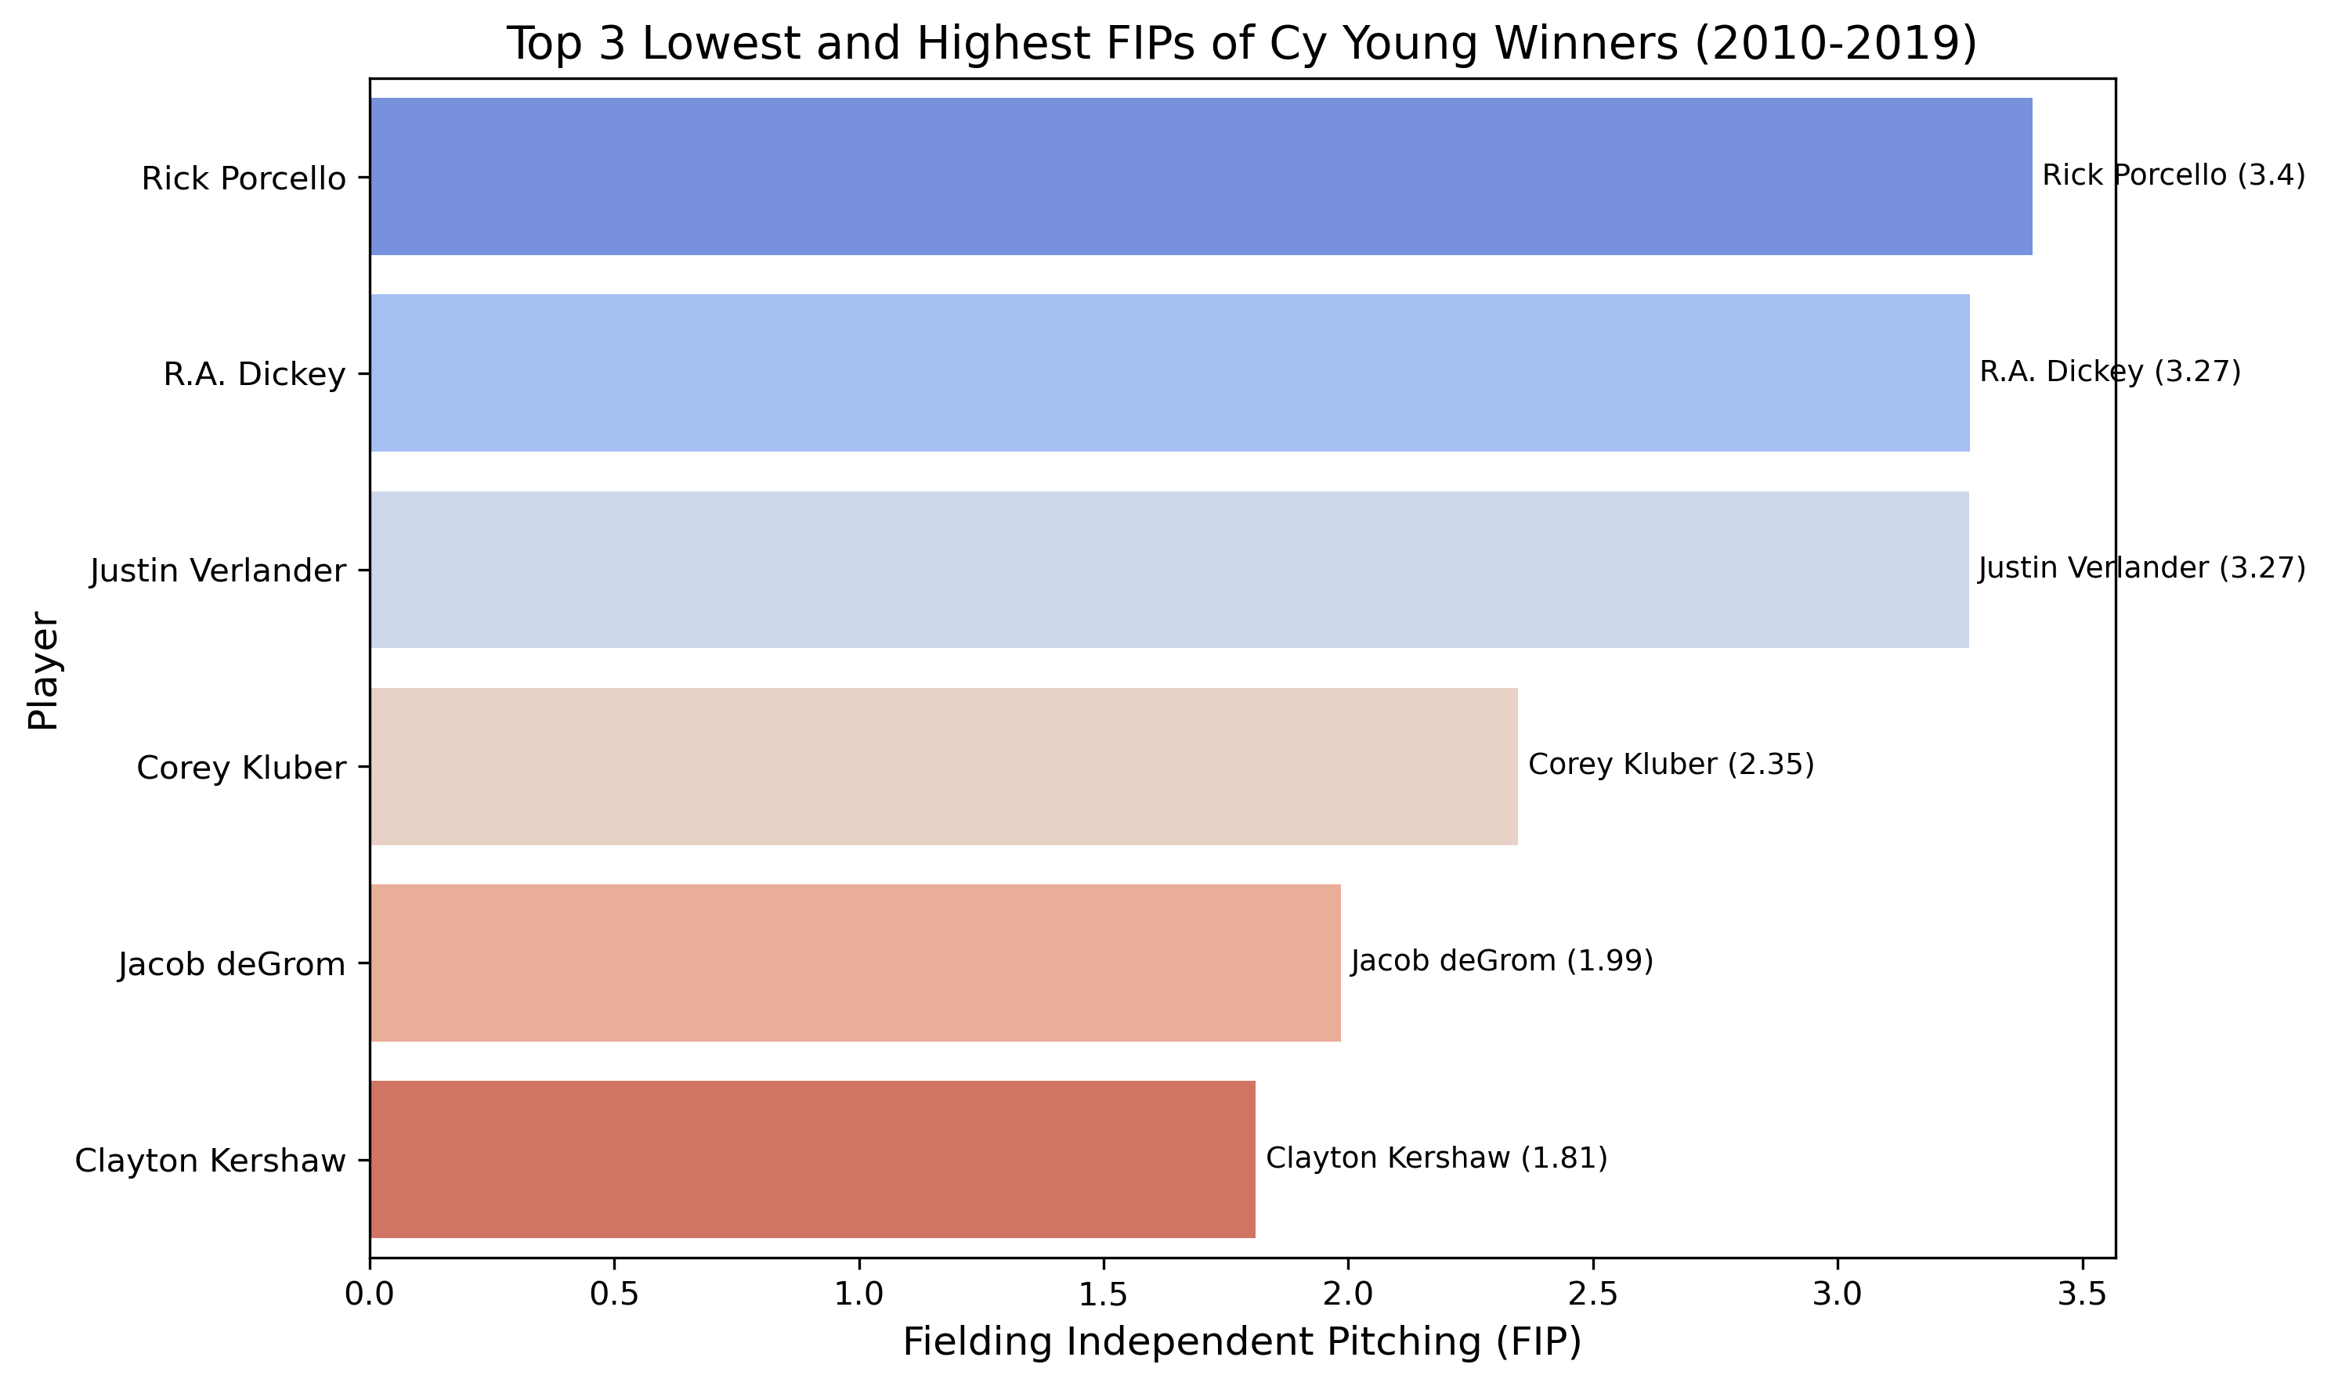
Fielding Independent Pitching (FIP)
FIP is a metric that focuses only on what the pitcher can control.

Slide 9
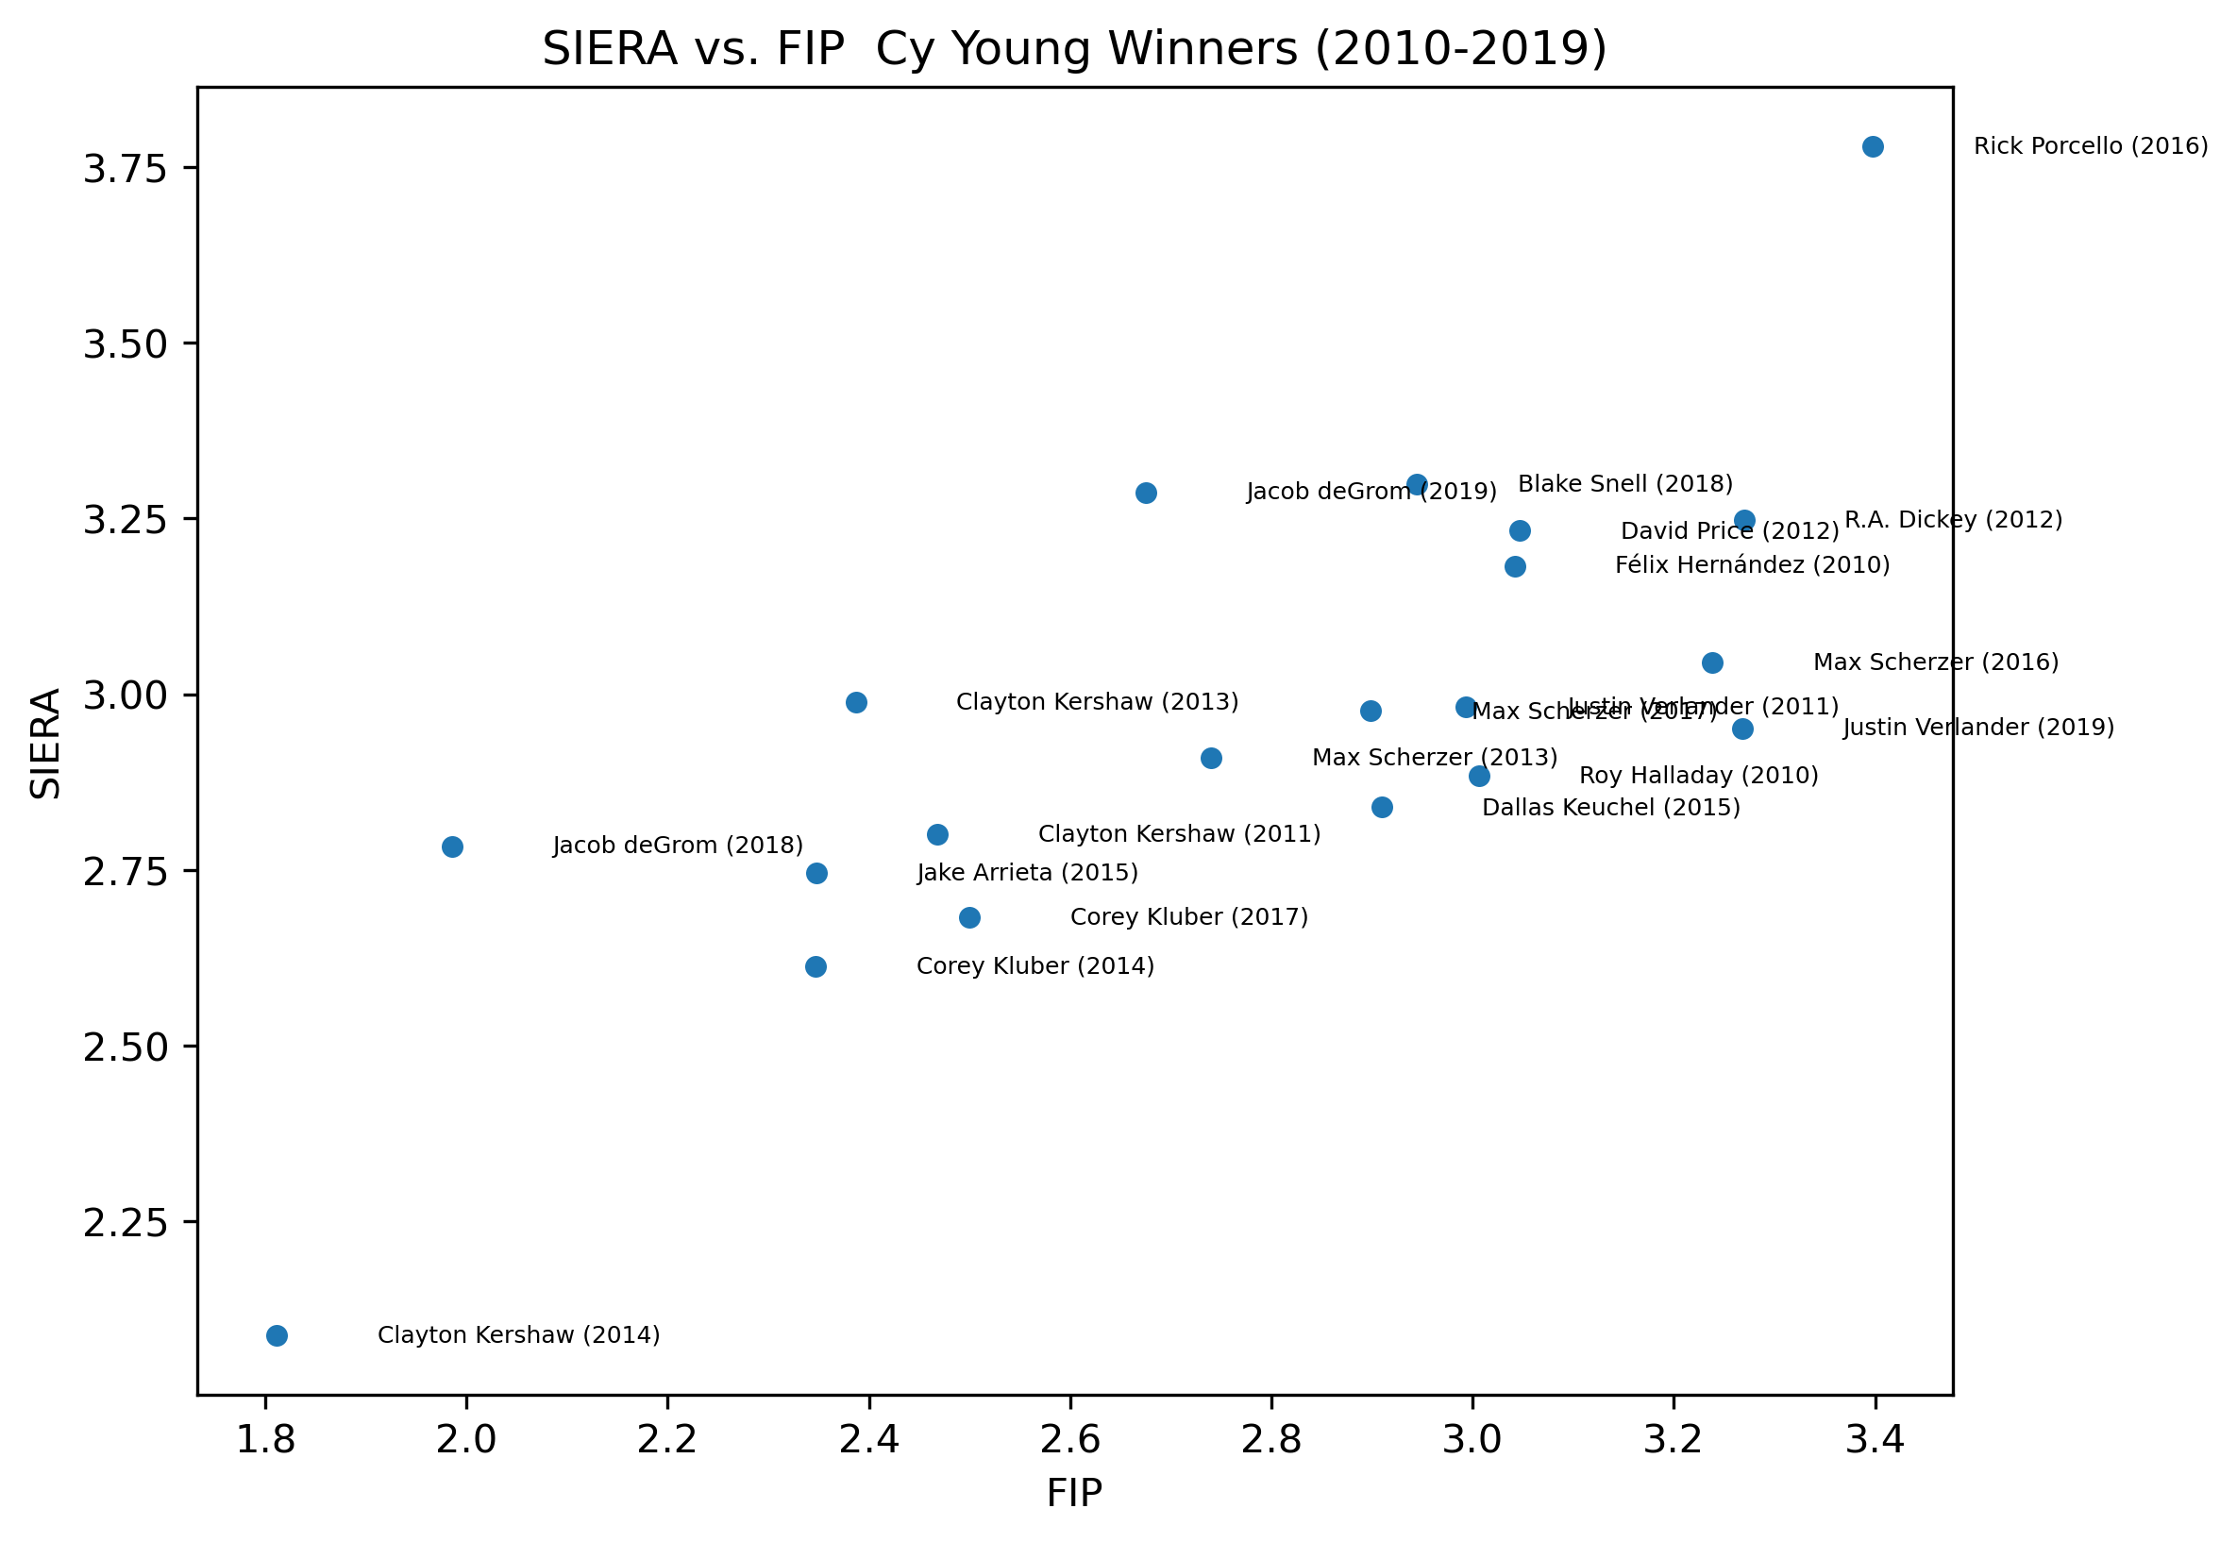
FIP vs SIERA
Skill Interactive Earned Run Average (SIERA) does not ignore balls in play.

Slide 10
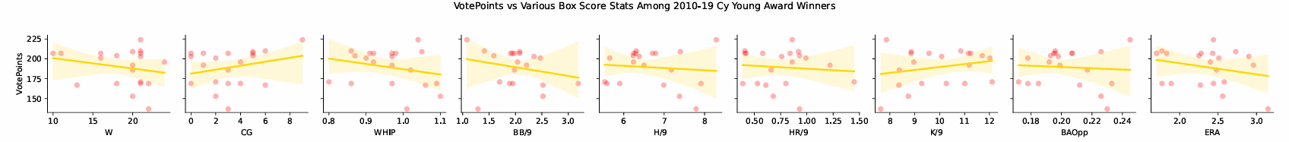
Analyzing the Correlation of Cy Young Vote Points and Various Box Score Statistics
Based on the above plots, it was determined that CG, WHIP, BB/9, K/9, ERA Correlation Coefficients should be calculated
Found:
BB/9 = -0.23
WHIP = -0.24
ERA = -0.25
K/9 = 0.23
CG = 0.26

Slide 11
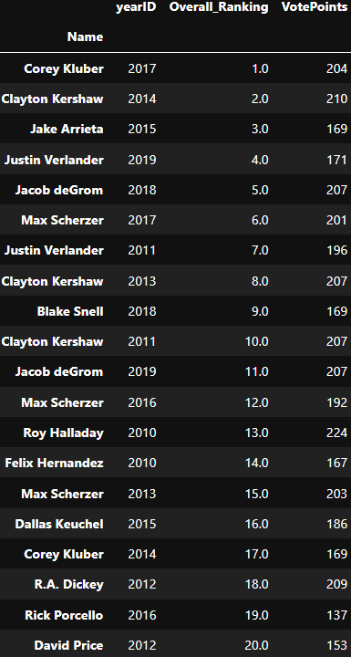
Who Was the Most Dominant Cy Young Winner Between 2010-2019 Based on the Ranking of Box Score Statistics?
Created Composite Borda Count Ranking Using Multiple Box Score Statistics
Included CG, WHIP, BB/9, H/9, K/9, OppBA, ERA
Excluded Wins
2017 AL Cy Young Winner Corey Kluber found to be the Most Dominant
2012 AL Cy Young Winner David Price found to be the Least Dominant
Raises Question -> Do voters decide based on box score stats or other unseen/more advanced metrics?

